Slide 1

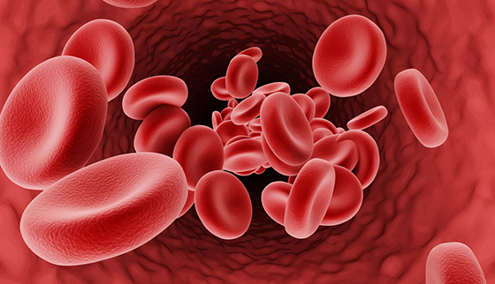
Detection and analysis of the genome for Haemoglobinopathies

Slide 2
Introduction
Haemoglobinopathies are common monogenic disorders with diverse clinical manifestations, partly attributed to the influence of modifier genes. Haemoglobinopathies are caused by mutations in the two globin gene clusters and are characterised by a reduced or absent synthesis of globin chains int he case of the thalassaemia syndromes, mainly alpha- and beta-thalassaemia, or by defects in the haemoglobin protein structure in the case of structural haemoglobin variants, such as the Hb S that causes sickle-cell disease

Slide 3
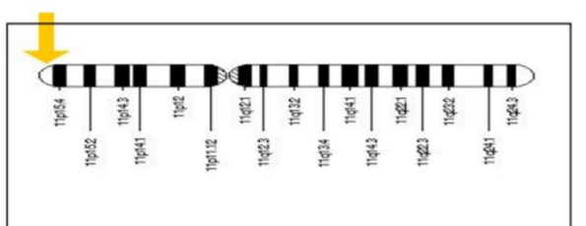
HBB gene, which is located on chromosome 11 p15.5, specifically located from base pair 5,225,464 to base pair 5,229,395 on chromosome 11.HBB gene contains 3exons separated by two introns , and has a length of1600bp.
Location of the HBB gene.

Slide 4
Haemoglobinopathies resulting from mutations in the α- or β‐ like globin gene clusters are the most common inherited disorders in humans, with around7% of the world population being carriers of a globin gene mutation. Single nucleotide substitutions can lead to amino acid replacements that cause hemolytic anemias, such as sickle cell disease, or hemoglobin that are unstable or have altered oxygen affinity.
Hb is responsible for binding and transport of oxygen and carbon dioxide by red blood cells and is critical for their shape, integrity and half-life. The Hb protein complex consists of two α -like chains, and two β- like chains. HBB gene contains three coding exons separated by two introns with the size around 1600bp which has been conserved throughout the evolution process.

Slide 5
α- Thalassemia
One of the most common genetic diseases, is caused by deletions or point mutations affecting one to four α-globin genes.
The diagnosis of α-thalassemia is complex due to a high variability of the genetic defects involved, with over 250 described mutations.
It has been stated that most commonly found mutations were deletions (with around 75%) and point mutations(substitution ,with25%).

Slide 6
β-thalassemia
Is one of the most prevalent forms of congenital blood disorders characterized by reduced hemoglobin levels with severe complications.
Is caused by 21 important mutations out of 200 point mutations published worldwide.
The type of Beta-Thalassemia depends on the severity of the mutation. If both parents carry this disorder it might be worse than if only one parent carries it.
Most common mutations of the HBB gene are:HBB:substitution
G>C (G->C), HBB:substitution G>A(G->A), HBB:substitution G>C (G->C), HBB:substitution G>T(G->T), HBB:substitution A>C(A->C) and less but still frequent one insertion HBB : insG and also some deleterious mutations.

Slide 7
β-thalassemia is usually caused by mutations involving one or a few nucleotides inβ-globin gene (HBB) or its immediate flanking region.
Mutations that completely abolish expression of the HBB are designated β⁰ alleles, while other mutations in HBB cause varying degrees of quantitative reduction inβ- globin expression and are classified as β+ orβ++.
They include single base substitutions, small insertions, or deletions within the gene or its immediate flanking sequences and affect almost every known stage of gene expression.

Slide 8
Mutation
HBB.C.47 G>A | HBB gene,C-coding DNA ,47 location in HBB sequence >- substitution (G→A)
HBB.C.92+5 G>C | HBB gene,C-coding DNA ,92+5 location in HBB sequence >- substitution(G→C)
HBB.C.124_127delTTCT | HBB gene,C-coding DNA ,124_127 lo-cation in HBB sequence,del - deletion(del TTCT)
HBB.C.124_127delTTCT (Codon41/42 – TTCT) | HBB gene,C-coding DNA ,124_127 lo-cation in HBB sequence,del - deletion(del TTCT),on Codon 41/42
HBB.C.27_28insG(Codon 8/9 (+G)) | HBB gene,C-coding DNA ,27_28 location in HBB sequence,ins - insertion(insertion of base G),on Codon 8/9

Slide 9
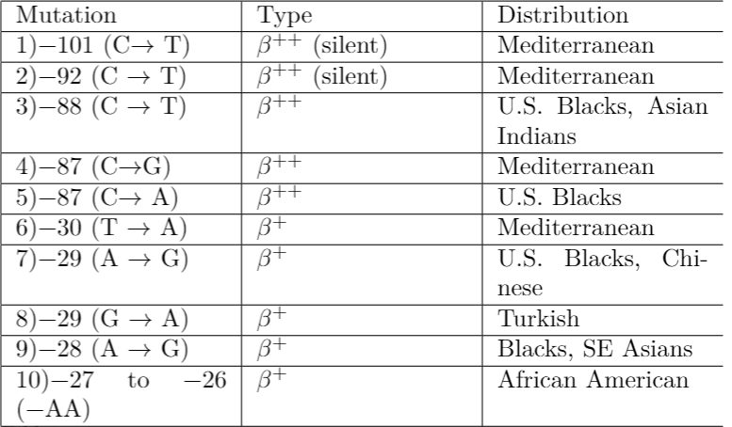
1.Transcriptional

Slide 10
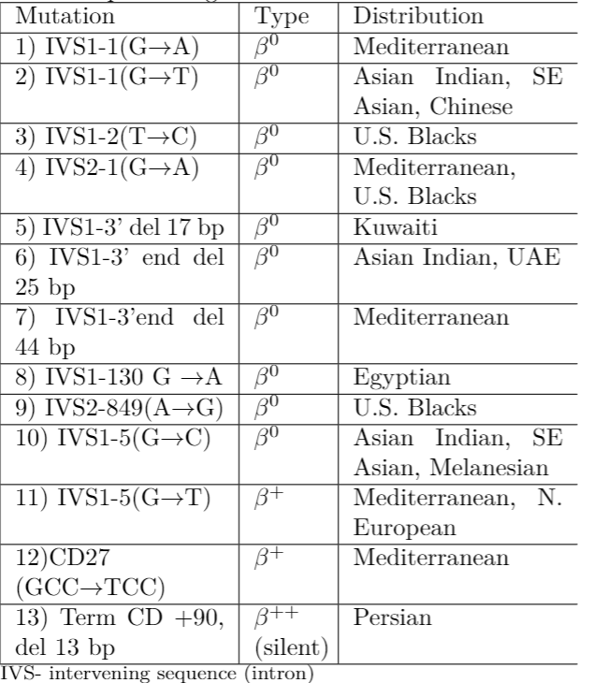
2.RNA processing

Slide 11
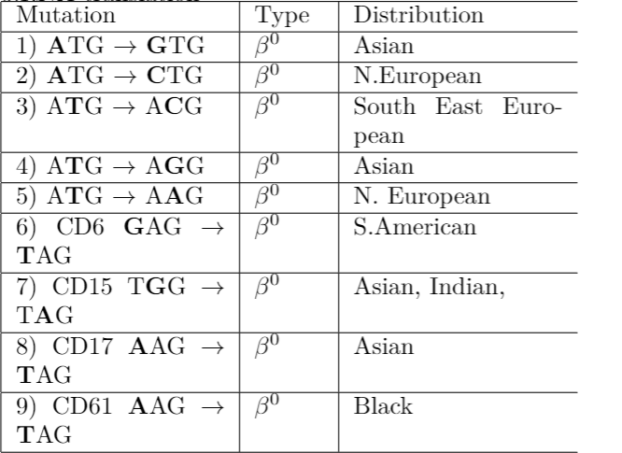
3.RNA translation

Slide 12
Sickle cell anemia
Common form of sickle cell disease, is caused by a particular mutation in the HBB gene.
This mutation results in the production of an abnormalversion of beta-globin called hemoglobin S or HbS.
In this condition, hemoglobin S replaces both beta globinsubunits in hemoglobin.
The mutation changes a single amino acid in beta-globin. Detection of a single base pair mutation at 6th codon of β-globin gene is important for the diagnosis sickle cell anemia. This mutation is labeled as rs334 mutation is responsible for hemoglobin S, known as HbS, which causes sickle cell anemia.

Slide 13
Related Work
Fettah A., Analyzed and tested for 106 Turkey patients gene sequences for B-globin gene mutations using DNA analysis. And classified as holding β-thalassemia major orβ-thalassemia intermedia based on their age at diagnosis.
Atanasovska B, Proposed approach applicable in a range of Mediterranean countries.Betaglobin detection further adapted to particular populationsby including/excluding assayed mutation. And facilitate future modifications by providing detailed information on assay design.
Verma IC, characterized the mutations in1050 carriers of the beta-thalassemia gene and analyzed their regional distribution in India. The majority of beta-thalassemia carriers were migrants from Pakistan and their pattern of mutations differed from the rest. he paper result helped to successfully establish a program of genetic counselling and prenatal diagnosis of beta-thalassemia in order to reduce the burden of this disease in India.

Slide 14
Related Work
P. Lahiry, suggested that “efforts to more completely characterize the HBB mutation distribution in high-risk areas, such as the Indian Subcontinent and the Middle East may lead to improved diagnosis with earlier and more effective intervention strategies. The concluded that beta-thalassemia is highly prevalent and is a major public health problem in the malaria endemic areas.
Abdul Hafeez Kandhro, proposed an approach of encoded and unlinked clinical laboratory data which were later evaluated with discrimination formulas, and computing approach for ensemble learning methods in bioinformatics, to get the to the statistically more correct formula for differentiation of beta-thalassemia mutations.
Monalisha Saikia Borah, presented a method for predicting hemoglobin variants with machine learning in bioinformatics.

Slide 15

BIOINFORMATICS TOOLS AND PROCESSES
1.FASTA: FASTA: For every bioinformatics tools selected to complete tasks. FASTA format is required to beset as a standard expression of the entire file to the elected bioinformatics tool. FASTA file could also help in find a sequence of the required gene against keywords.
2. ClustalW: it is a powerful technique for checkup the sequences similarity whether the patient has malignant mutation related to abnormal disorder or no. by using it within BioEdit package. It can also provide the way to monitor the processes of transcription and translation to get protein sequences that control the function in gene. In this approach, ClustalW accept FASTA file that contains normal gene sequence (HBB gene sequence) and sequence from a patient HBB gene in order to compare both sequences.
3. BLAST: the basic local alignment search bioinformatics tools to searching for similarities between biological sequences which performs comparisons between pairs of sequences, searching for regions of local similarity to start sequence analysis

Slide 16

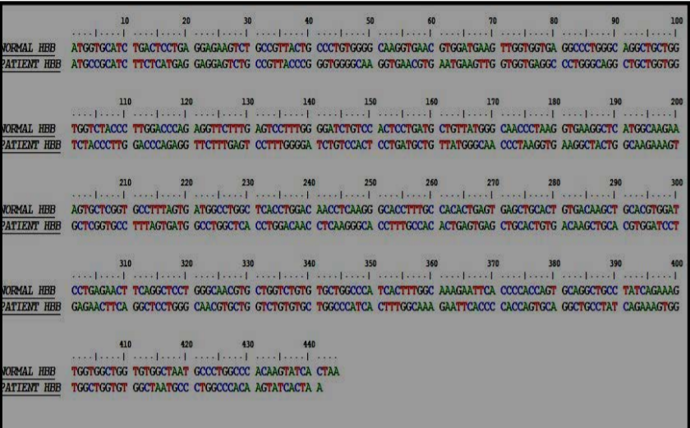
The procedure will follow as , firstly we make FASTA file from HBB gene from a patient provided by the databases we use (ITHAGENES and HbVar).
Check Nucleotide alignment Of The Entire Sequences.
Seq1 !=Seq2?
Use Alignment Tool(Pairwise Alignment) for SimilarityCheck.
Differences Found? (Seq1 !=Seq2)?
ThenHBB Gene is at Risk and it is Candidate for ThalassemiaDisease.
(Normal and Patients HBB Sequence File)

Slide 17
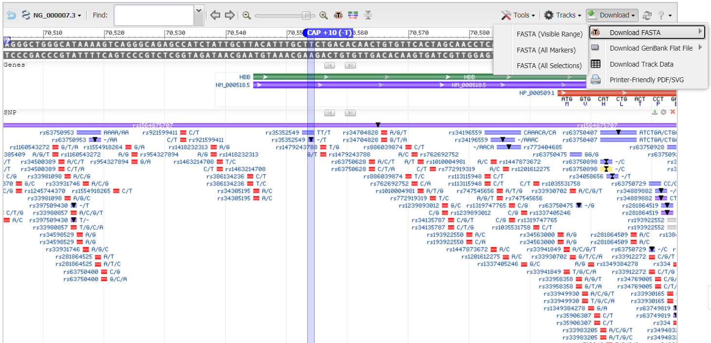
1.Obtaining the normal HBB gene sequence from official bioinformatics databases.
NCBI—> Gene-> Reference genome-> HBB genesequence
HBB gene sequence databases , IthaGenes or HbVar to find a sequence.

Slide 18
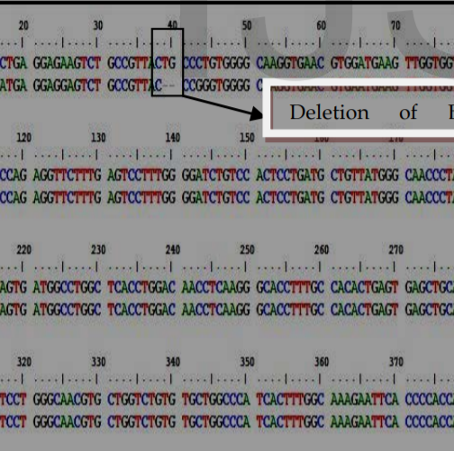
HBB gene sequence and patient gene sequence is used as FASTA file input to the bioedit package tool to test the patient’s gene if its healthy or hold somatic mutations that causes thalassemia.

Slide 19
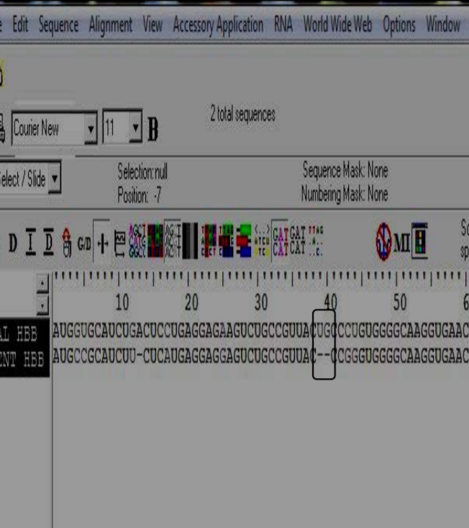

The clustalW tool is used for alignment of the two HBB sequences at Nucleotide level.
In this stage and because the result shows mutation in some positions on patient’s gene. This means that there is a chance of having Beta thalassemia. In order to make sure of this result the two sequences should convert to protein via DNA-RNA Protein sequences to find if the gene changes its function.

Slide 20
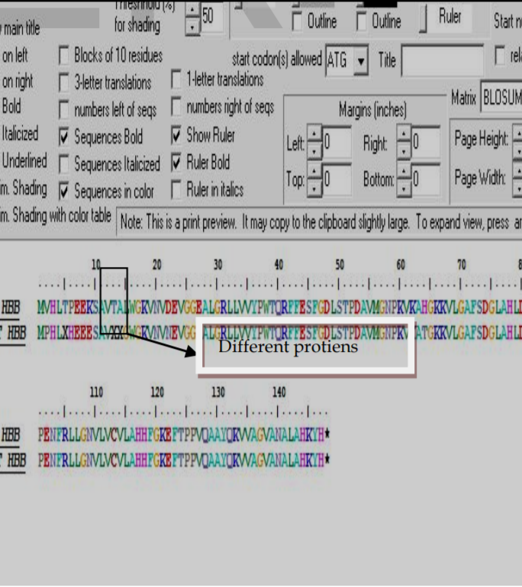
The final stage is the protein sequence convertion (translation process).If differences occure a gain then the gene is abnormal and the disease has actually happened.

Slide 21
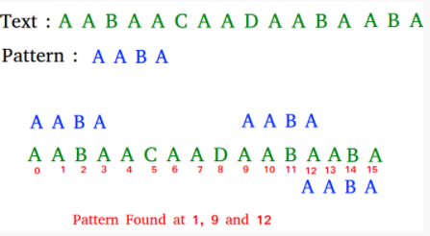
Boyer Moore Algorithm
Boyer Moore Algorithm for Pattern Searching.
BoyerMoore algorithm preprocesses the pattern.
Boyer Moore is a combination of following two approaches : Bad CharacterHeuristic and Good Suffix Heuristic.
(Example of the Booyer-Moore sequence compare)

Slide 22
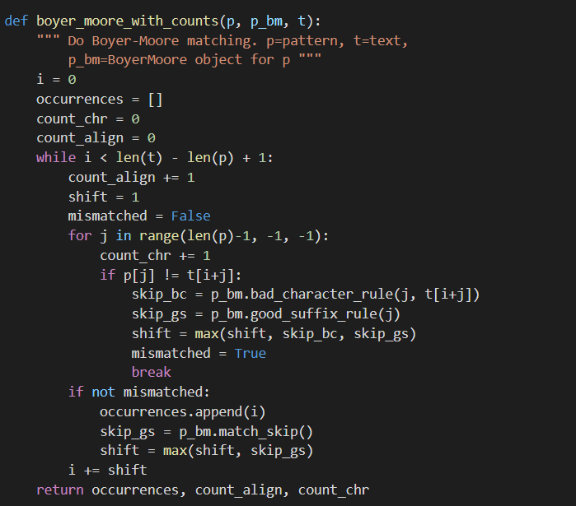
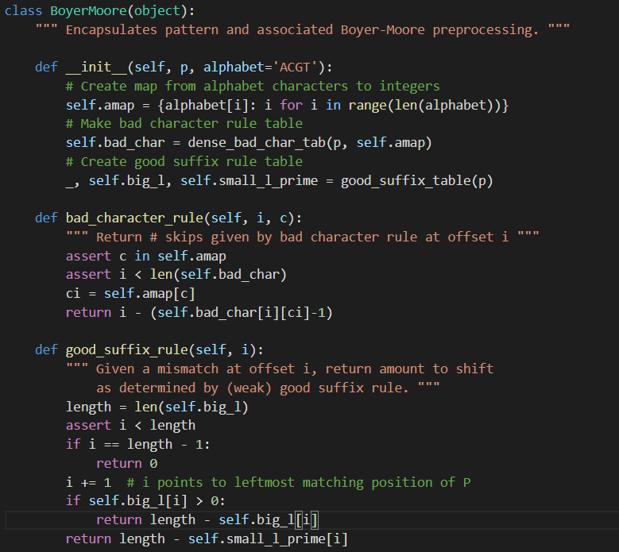

Slide 23
Discussion
Our aim from the beginning was to determine an approach that could lead to detection of a mutation in a patient nucleotide sequence ,with comparison to the normal HBB gene.
The weakness of all these methods and techniques they focused in diagnosticor detecting thalassemia were based on genes mutations locally. Means that comparison of patients’ gene was made to conclude specific annotations and mutations int he selected country.
The aims of this project we will state them as analysis, alignment and mutations check compared to a healthy gene. With two sequences necessary to fulfill the proposed test.

Slide 24
Conclusion
The proposed approach gives accurate results for detecting the mutations for haemoglobinopathies.
This new approach suggested a general prediction method based on mutational in genes that cause the disease, i.e. can implement this novel method for any disease when the mutations of its gene that caused the disease are known.
Offers an automatic, cost effective and friendly diagnosis system for detecting mutations for haemoglobinopathies,with previously given sequences.

